Slide 1
WORKFORCE INVESTMENT COUNCIL
QUARTERLY BOARD MEETING
February 16, 2022

Slide 2
I. WELCOME & CALL TO ORDER
ANTWANYE FORD
CHAIRMAN

Slide 3
AGENDA
Welcome & Call to Order
Chairman’s Comments
Director’s Updates
Board Discussion and Updates
Board Vote: Approval of DC's Unified WIOA State Plan Update
Public Comments
Adjourn
3

Slide 4
II. CHAIRMAN’S COMMENTS
ANTWANYE FORD
CHAIRMAN

Slide 5
III. DIRECTOR’S UPDATES
AHNNA SMITH
EXECUTIVE DIRECTOR

Slide 6
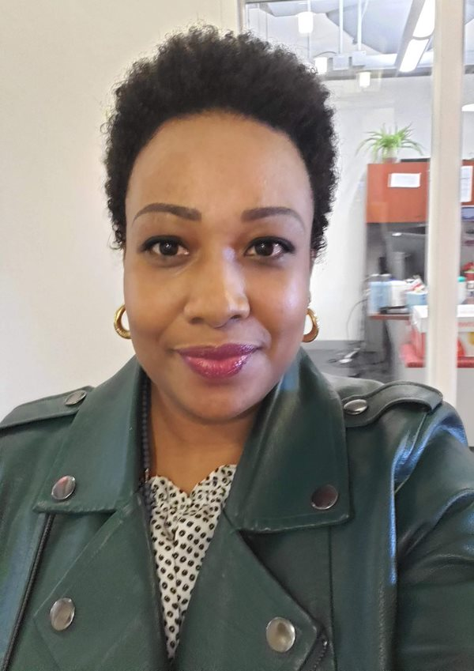
Welcome New WIC Staff!
Abigail Blanchard
Grants Management Specialist
Jyothis Sreekumar
Data Manager
Matthew Lesser
Grants Management Specialist

Slide 7
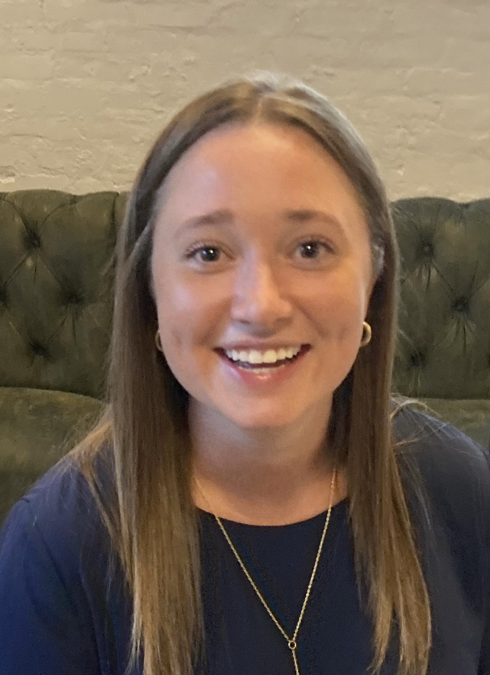
Welcome New WIC Staff!
Anika Holmes
Associate Director, Business Engagement
Lillian Speranza
Program Analyst

Slide 8
8

Slide 9
FY22 RECOVERY INVESTMENTS
Goal | Strategy | Investment | Projected Impact | Status
Drive Inclusive Jobs Recovery | Prioritize employer-driven training | Employer-led training partnerships | ~750 workers impacted, annually | 10 applications submitted in first round (6 eligible) Final deadline: April 15th
 | Strengthen employer-job-seeker connections | Career Coach DC | Serve up to 5,000 residents, annually | Grant solicitation closes 2/18 7 applications begun in online portal
 | Drive surge in high-impact credentialing | IT Workforce Investment (UDC and training grants) | Free workforce, AA, BA training at UDC for IT credentials (175 students) IT training grants (~100-150 participants) | MOU with UDC complete; working to transfer funds Grant solicitation in March
 |  | Nursing Workforce Investment (UDC and training grants) | Free workforce, AA, BA training at UDC for Healthcare credentials (160 students) Healthcare training grants (~100 participants) | MOU with UDC complete; working to transfer funds Grant solicitation in March
9

Slide 10
FY22 RECOVERY INVESTMENTS
Guidance from the Board of Ethics and Government Accountability (BEGA):
Companies and organizations of WIC Board members can apply for grants but that the individual WIC board members should not be involved in the application process.
If a company that is also the employer of a WIC board member would like to apply for grants, they should have someone from the company other than the WIC board member apply. Where that is not possible a third-party representative (i.e., an attorney) should be brought in to handle grant matters on behalf of the WIC board member or company.
WIC board members, whose companies are applying, should not sign grant documents and submit them to your office, be involved in votes or meetings regarding the grants process, etc.
WIC has put in place an impartial evaluative process for considering grants—WIC staff are not involved in scoring grant applications to ensure review of applications is impartial and lacks preferential treatment.
10

Slide 11
US DEPARTMENT OF LABOR MONITORING
Finding | Details | Response | “So What”
WIC is not conducting oversight in line with its policies | WIC Policy Manual states that DOES will submit to WIC quarterly info about services and fiscal reporting on the WIOA grant. | Addressed In addition to WIOA reporting monthly on services that DOES provides (above and beyond what's in our policy), DOES will provide to WIC the quarterly fiscal report on the WIOA grant that they also submit to DOL. WIC will update our Policy Manual to reflect this update. | This is an opportunity for WIC to receive additional information that we haven’t previously received; enables WIC to play its role as advisor to the system.
WIC does not consult on procurement of Youth Services | Per WIOA, WIC is required to provide direction on procurement of Youth Services and has not historically done so. | Addressed DOES will submit to WIC draft solicitations for Youth Services for review/feedback 2 weeks before posting with OCP. | This clarifies what had been a gray area, and together we have identified a process that works to ensure compliance, expand and enable WIC to fulfill its role, and works within DOES/OCP processes and requirements. WIC staff will review and provide feedback to DOES.
WIC did not publish ETPL list in accordance with DOL requirements | Information must be posted on ETPL for public that includes information about courses and participant outcomes. | Addressed The ETPL has been updated to include all required information | Much of the information had already been available in DC Networks. WIC and DOES will continue to work together to ensure this information is maintained and posted.
11

Slide 12
FY21 Expenditure Guide Summary
A total of 16 agencies reported offering 56 workforce development/ adult education programs, Partnering with approximately 124 community providers, agencies served a total of 50,607 residents, a 12% decrease from the previous year.
Agencies reported a total budget of $119, 227,074 and spent approximately $100,511,639.
Approximately 41% of participants were represented by DOES, followed by DSLBD (29%), MOLA (15%), DHS (6%), and UDC (3%). However, the agencies with the largest budgets included DOES (57%), DHS (29%), OSSE (5%), DSLBD (3%), and DOEE (2%).
The number of program participants decreased by 12% from the previous year to a total of 50,607 participants; however, the total number of participants completed increased by 5%, for a total of 37,197 participants.
A total of 1448 participants earned a credential.
The number of participants employed increase by 196%, for a total of 1094 participants
The most popular industries offered were Hospitality (46%), Healthcare (43%), Business Administration & Information Technology (39%), Education (38%), and Construction and Transportation were tied (36%)
Notes:
The impact of COVID-19: Several agencies suspended some of their programs, such as DCHA which typically offers five programs, reduced to two programs and OCTFME, who offered three programs last year only .

Slide 13
ETPL Policy Update
Revised ETPL policy updates completed in February 2022
Input from EWA Committee, engagement with training providers, and in consultation and partnership with DOES, OCP, and HELC.
Summary of changes:
Reciprocity language added.
Data Collection changed from annually to quarterly.
Providers will now have one year of ETPL eligibility starting at the beginning of the quarter that they were deemed eligible to be on the list as opposed to from Jan. 1-Dec. 31 of the current years.
Performance Requirements have been added to mirror partner agencies with stricter performance guidelines.
Notes:
to provide better context for potential ETPs
to allow for ease of data collection
Definitions were added to the top of the policy.
The “failure to meet 80 percent of the required performance levels for each of the performance indicators” line item was removed from IX: Failure to Meet Performance Requirements.
This allows providers who enter the ETPL later in the year to not have to provide continued eligibility information that they may not have due to the timing of their eligibility.
to allow for a more streamline approach to add providers outside of the WIC’s jurisdiction
This allows for all ETPL providers on the list to be eligible to apply and be selected to receive Human care Agreements.
This statement made it for providers that would not be eligible to receive HCAs to remain on the ETPL.

Slide 14
Marshall Memorial Fellowship
Ahnna will be OOO March 16 – April 10​
Will check email daily (will set schedule and share with team once calendar for trip confirmed)​
Will meet weekly with Exec Team​
Will prepare for any reviews, approvals, or weigh-in that may be needed during that time—AND/OR will clearly delegate those decisions or items to Rosa or Suzanne.​
Purpose is to share with and learn from European counterparts about their efforts in workforce and economic development, education, local government, etc.​
Cities will visit: Brussels, Copenhagen, Rome, Budapest, Berlin
Notes:
to provide better context for potential ETPs
to allow for ease of data collection
Definitions were added to the top of the policy.
The “failure to meet 80 percent of the required performance levels for each of the performance indicators” line item was removed from IX: Failure to Meet Performance Requirements.
This allows providers who enter the ETPL later in the year to not have to provide continued eligibility information that they may not have due to the timing of their eligibility.
to allow for a more streamline approach to add providers outside of the WIC’s jurisdiction
This allows for all ETPL providers on the list to be eligible to apply and be selected to receive Human care Agreements.
This statement made it for providers that would not be eligible to receive HCAs to remain on the ETPL.

Slide 15
IV. BOARD DISCUSSION
AND BOARD MEMBER UPDATES
ANTWANYE FORD, CHAIRMAN
AHNNA SMITH, EXECUTIVE DIRECTOR

Slide 16
WIOA STATE PLAN MODIFICATION
District of Columbia 4-year Workforce Development System Strategic Plan Published in 2020
Workforce Innovation and Opportunity Act (WIOA) passed in 2014 identified the framework and requirements of the plan, and US DOL and US DOE issued joint guidance that gave further instruction to states as to how to complete the plan.
Review and modify (as necessary) in 2022
This is intended to be a mid-point update and adjustment, the pandemic called for adjustments to the plan.
A more comprehensive update or new version of the plan will be due that again must meet the WIOA law and regulations in 2024.

Slide 17
WIOA STATE PLAN MODIFICATION
WORKFORCE DEVELOPMENT VISION
Every DC resident is ready, able, and empowered to discover and attain their fullest potential through lifelong learning, sustained employment, and economic security.
Businesses are connected to the skilled DC residents they need to compete globally, are full participants in the workforce system, and drive the District’s economic growth.
Residents and businesses in all eight wards are supported by a system that includes coordinated, cohesive, and integrated government agencies and partners working to help communities thrive.

Slide 18
WIOA STATE PLAN MODIFICATION
Five Workforce Development Goals
Enhance System Alignment
Improve Community Access to Workforce and Education Services
Expand the Talent Pool for Businesses
Improve Youth Services
Increase Performance and Accountability

Slide 19
WIOA STATE PLAN MODIFICATION
TIMELINE
Draft mid-year state plan was released for review and Engagement Sessions have been scheduled for feedback. Public engagement will include Education and Training Community, Service Providers, the General Public and Business. The schedule is as follows:
January 26th –February 1st —Three public engagement sessions
February 2nd—WIOA State Plan Steering Committee discussion
February 15th—Submit final draft document to CA’s Office for IQ
February 16th—DC WIC Board meeting and vote
February 25th—Final draft posted on DC Register for 5 business days
March 15th—Due date for submission of the final plan by the WIC via the DOL portal

Slide 20
WIOA STATE PLAN MODIFICATION
BOARD VOTE
“I move to approve the 2022 WIOA State Plan Modification, pending approval by the Executive Office of the Mayor.”

Slide 21
BOARD MEMBER UPDATES
We welcome WIC Board members to provide updates, announcements, or opportunities that they would like to share with the group.

Slide 22
VI. PUBLIC COMMENT

Slide 23
VII. ADJOURN

Slide 24
APPENDIX

