Slide 1
Section 188 Equal Opportunity & Accessibility for People with Disabilities in American Job Centers
Presented by:
The Workforce Investment Council of Washington, DC
In collaboration with the LEAD Center
April 26, 2018
Notes:
Lauren – Welcome & set overall tone for training

Slide 2
Presenter #1
Lauren Scott
WIOA Program Manager
Workforce Investment Council
Government of the District of Columbia
Office of the Deputy Mayor for GEO,
Washington, DC
lauren.scott@dc.gov
Notes:
Lauren – intro’s herself with another slide for office

Slide 3
DC Workforce investment council
The District of Columbia Workforce Investment Council develops comprehensive strategies, policies, and partnerships to deliver accessible and effective education, training, and support services in response to the workforce needs of DC residents and employers.
Notes:
Lauren
Business-led Board, comprised of 36 members, responsible for advising the Mayor, City Council, and District government on the development, implementation, and continuous improvement of an integrated and effective workforce system.
The DCWIC is staffed by a team of workforce development experts who implement the Mayor’s and the Board’s vision through research, data analysis, policy development and technical assistance.

Slide 4
Presenter #2
Jamie Robinson, MA
LEAD Center
Technical Assistance
National Disability Institute
Washington, DC
Jrobinson@ndi-inc.org
Notes:
Jamie brief intro of herself

Slide 5
Presenter #3
Rebecca Salon, Ph.D.
LEAD Center Project Director
National Disability Institute
1667 K Street, NW
Washington, DC
rsalon@ndi-inc.org
Notes:
Rebecca brief intro of herself

Slide 6
The National Center on Leadership for the Employment and Economic Advancement of People with Disabilities (LEAD) is a collaborative of disability, workforce and economic empowerment organizations led by National Disability Institute with funding from the U.S. Department of Labor’s Office of Disability Employment Policy, Grant No. #OD-23863-12-75-4-11.
This document does not necessarily reflect the views or policies of the U.S. Department of Labor’s Office of Disability Employment Policy, nor does the mention of trade names, commercial products, or organizations imply endorsement by the U.S. Government.
Notes:
Rebecca

Slide 7
LEAD Center Mission
To advance sustainable individual and systems level change that results in improved, competitive integrated employment and economic self-sufficiency outcomes for individuals across the spectrum of disability.
www.leadcenter.org
Notes:
Rebecca

Slide 8
Training objectives
To increase understanding of:
WIOA & Disability
WIOA Core Program Requirements
Section 188 and ADA
Section 188 and AJC Certification
To clarify and outline roles and responsibilities of:
State Equal Opportunity Officer
Recipient-Level Equal Opportunity Officers
AJC Leadership and Staff
WIOA partners, such as Vocational Rehabilitation
To highlight resources and partners that can support Section 188 implementation around:
Physical Access
Programmatic Access
Effective Communication
Notes:
Lauren – Overview of training objectives, plus hopes for meeting today, identifying challenges & action steps

Slide 9
Discussion points & Action steps
Throughout today’s training, we will stop and engage in group discussion.
These discussion points will provide an opportunity to:
Ask questions and provide examples
Clarify information and roles in Section 188 of WIOA
Highlight promising practices in workforce services that improve equal opportunity and accessibility
Share success stories in serving people with disabilities
Share challenges in serving people with disabilities and brainstorm solutions as a group
Determine Action Steps that can be taken to expand accessibility and equal opportunity in your role/program area
Notes:
Lauren

Slide 10
KEY FEATURES OF WIOA
Notes:
Lauren

Slide 11
WIOA Core partners/programs
WIOA is designed to strengthen and improve the nation’s public workforce system, through a network of one-stop career centers (also referred to as American Job Centers AJCs), which provide an array of employment services and connect customers to work-related training, education and support services.
There are four titles for WIOA core partners/programs, which are aligned to provide coordinated, comprehensive services, including:
I. Adult, Dislocated Worker & Youth formula programs administered by Department of Labor (DOL)
II. Adult Education and Literacy programs administered by Department of Education (ED)
III. Wagner-Peyser Employment Service program administered by DOL
IV. Programs under Title I of the Rehabilitation Act as amended by
WIOA Title IV that provide services to individuals with disabilities
administered by ED
Notes:
Lauren

Slide 12
Key features of wioA
Each state is required to develop a four year plan that includes and coordinates all four titles.
WIOA necessitates development of integrated intake, case management and reporting systems.
WIOA requires establishment of a common performance accountability system for the four core programs.
WIOA streamlines and strengthens strategic roles of State and local workforce boards.
WIOA extends State-established certification for One-Stops to include all four titles.
Notes:
Lauren – Will review key components of DC’s unified combined state plan
*Rebecca may add DC promising practice in the state plan

Slide 13
Nondiscrimination Plan Requirements
Notice and Communication
Affirmative Outreach
Monitoring
Complaints
Data and Information Collection/Maintenance
Notes:
Lauren

Slide 14
WIOA and disability
Individuals with disabilities must be a part of State/Local Strategic Plans.
Performance outcomes must be identified and reported, including outcomes for people with disabilities.
Criteria for certifying One-Stops must include assessing physical and programmatic accessibility, including effective communication, facilities, programs, services, technology and materials, and appropriate staff training.
As a Core Partner of WIOA, Vocational Rehabilitation (VR) receives guidance from State/local boards.
Notes:
Lauren passes on to Jamie

Slide 15
SECTION 188
Notes:
Jamie

Slide 16
WIOA Section 188
Section 188:
Implements the nondiscrimination and equal opportunity provisions of WIOA, which are contained in Section 188 of the statute.
Prohibits discrimination on the grounds of race, color, religion, sex, national origin, age, disability, political affiliation or belief, among other bases.
Requires that reasonable accommodations be provided to qualified PWD in certain circumstances.
Contains provisions identical to those in Section 188 of WIA.
Can be found at 29 CFR Part 38.
Notes:
Jamie

Slide 17
Who does Section 188 apply to? (29 CFR §38.2, 38.4)
“Recipients” are defined as:
Any entity to which financial assistance under WIOA Title I is extended, including:
State level agencies that administer or are financed by WIOA Title I funds,
State Employment Security Agencies,
State and local Workforce Investment/Development Boards,
One-Stop Operators,
Service providers, including eligible training providers,
On-the-Job Training employers,
Job Corps contractors and center operators (excluding federally-operated Job Corps centers, and
Programs and activities that are part of the One-Stop delivery system that are operated by One-Stop partners.
Notes:
Jamie

Slide 18
WIOA Section 188 FINAL RULE
New WIOA Section 188 regulations effective Jan 3, 2017.
U.S. DOL Civil Rights Center announced publication of Final Rule updating Section 188 WIOA Nondiscrimination and Equal Opportunity Regulations (29 CFR Part 38).
Final Rule provides important updates to the existing regulations, which have not been updated since 1999.
Final Rule brings regulations in accord with ADA Amendments Act and implementing regulations and guidance issued by Department of Justice and Equal Employment Opportunity Commission.
Notes:
Jamie

Slide 19
WIOA Section 188 FINAL RULE: DIsability
Final Rule enhances access for people with disabilities, individuals with limited English proficiency, transgender individuals who may face various forms of sex discrimination, and individuals who are pregnant, have had a child or have related medical conditions.
Final Rule ensures that the definition of “disability” will be interpreted broadly to enable more individuals with disabilities to be effectively served within workforce system.
Final Rules on DOL-CRC’s website: www.dol.gov/crc
CRC Fact Sheet on Section 188 Final Rule: https://www.dol.gov/crc/188rule/fact-sheet.htm
http://leadcenter.org/system/files/resource/downloadable_version/Sec_188_Final%20Rule_Summary_Dec_2016.pdf
Notes:
Jamie

Slide 20
Definition of disability
Disability means, with respect to an individual:
A physical or mental impairment that substantially limits one or more major life activities of such individual;
A record of such an impairment; or
Being regarded as having such an impairment.
“Substantially limits” is not meant to be a demanding standard.
This is the same definition of disability as the ADA.
ADA Amendments Act of 2008 P.L. 110-325 Section 3
Notes:
Jamie

Slide 21
Definition of qualified individual with a disability
With respect to employment, an individual who satisfies the requisite skill, experience, education, and other job-related requirements of the employment position, and who, with or without reasonable accommodation, can perform the essential functions of such position.
With respect to aid, benefits, services, or training, an individual who -- with or without auxiliary aids and services, reasonable accommodations, and/or reasonable modifications in policies, practices, and procedures -- meets the essential eligibility requirements for such aid/benefit/service/training.
Notes:
Jamie

Slide 22
Reasonable accommodations
With regard to any aid/benefit/service/training, and employment, workforce partners must provide reasonable accommodations to qualified individuals with disabilities unless it would cause undue hardship.
Reasonable accommodation means:
Modifications or adjustments to an application/registration process that enables a qualified applicant/registrant with a disability to be considered for the aid/benefits/services/ training/employment they desire; or
Modification or adjustments that enable a qualified individual with a disability to perform the essential functions of a job, or to receive aid/benefits/services/training equal to that provided to qualified individuals without disabilities.
Notes:
Jamie

Slide 23
Disability discrimination
Discrimination prohibited based on disability:
Denying a qualified individual with a disability the opportunity to participate in or benefit from the aid/benefit/service/training.
Providing a qualified individual with a disability with any aid/benefit/service/training that is not equal to what is offered to others or that is not as effective.
Requiring a qualified individual with a disability to participate in separate or different programs or activities instead of mainstream programs/activities.
Not administering programs and activities in the most integrated setting appropriate to the needs of qualified individuals with disabilities.
Not providing meaningful opportunities for seeking employment and work in competitive integrated settings.
Notes:
Jamie

Slide 24
Discussion point & action steps
What is your role in Section 188? Is it at a policy level, practice level or both?
State Equal Opportunity Officer
Recipient-Level Equal Opportunity Officers
AJC Leadership and Staff
WIOA partners, such as Vocational Rehabilitation, Adult Education, Career Pathways partners
How do you recognize when someone is disclosing a disability?
How do you respond to an accommodation request?(JAN Handout)
Can you think of an example of disability discrimination? How could this be prevented?
Notes:
Lauren - Lead discussion

Slide 25
SECTION 188 &
AJC CERTIFICATION
Notes:
Jamie

Slide 26
Section 188 is the framework for ajc certification
Under WIOA, all four titles/programs are responsible for aspects of:
Delivering AJC services
Providing AJC maintenance
AJC Certification
TEGL 16-16
Section 188 is the required framework for this process and divides program accessibility into three areas of compliance:
Physical access
Programmatic access
Effective Communication
Notes:
Jamie
- WIOA Core Partners share responsibility for aspects of service delivery and Section 188.
- Section 188 is a part of the regulatory framework for AJC Certification criteria and processes.
- EOOs and VR agencies are engaged in AJC Certification as SMEs in compliance and accessibility.
- AJCs and partners need resources/strategies to effectively implement both Section 188 and AJC Certification.

Slide 27
Physical access
ADA Accessibility Guidelines (ADAAG) contains scoping and technical requirements for accessibility to buildings and facilities by individuals with disabilities under ADA of 1990.
Requirements are to be applied during design, construction, and alteration of buildings and facilities covered by Titles II and III of the ADA issued by Federal agencies, including Department of Justice and Department of Transportation.
Common trusted resources for supporting physical access:
DC Center for Independent Living (CILs)
Regional ADA Centers – Mid-Atlantic ADA Center
Mayor’s Offices/Departments on Disabilities (e.g., DDS)
Notes:
Jamie

Slide 28
Physical access: strategy
ADA Accessibility Guidelines (ADAAG) surveying and checklists facilitated by ADA subject matter experts in conjunction with leadership to assess physical access of One-Stop Centers in parking, entrances, building, bathrooms, internal space and other essential areas outlined in the guidelines.
Accessibility requirements, solutions to barriers and technical assistance offered to One-Stop Centers at the conclusion of assessment.
Notes:
Jamie

Slide 29
Physical access: discussion
Are there designated accessible spaces and Van accessible parking spaces?
Are there curb cuts so wheelchairs can get to the door?
Can a wheelchair get in the door and move around easily inside the AJC?
Is there signage throughout AJC with pictures showing where to go and disability symbols?
What happens when someone requests assistive technology? Do you know where it is and how to use it?
What happens when a deaf customer requests a sign language interpreter?
Other examples of physical accessibility?
Notes:
Jamie & Lauren

Slide 30
PROGRAMMATIC ACCESS
Under WIOA Section 188, Core Partners of One-Stops must assess programmatic accessibility in which:
“policies, practices, and procedures must provide effective and meaningful opportunity for persons with disabilities to participate in or benefit from aid, benefit, service and training”.
This definition is different than the similar term “program accessibility” in ADA Title II, which refers to accessibility of facilities, programs, services, technology, and materials for individuals with disabilities.
The 188 definition is more encompassing, requiring One-Stop Centers to ensure full participation of people with disabilities from policy to practice.
Notes:
Jamie

Slide 31
Programmatically accessible
All WIOA Title I-financially assisted programs and activities must be programmatically accessible, including:
Providing reasonable accommodations for individuals with disabilities.
Making reasonable modifications to policies, practices, and procedures.
Administering programs in the most integrated setting appropriate.
Communicating with individuals with disabilities as effectively as with others, and providing appropriate auxiliary aids or services, including assistive technology to afford equal opportunity to participate in, and enjoy the benefits of, the program or activity.
Notes:
Jamie

Slide 32
Programmatic access = outcomes
“…to afford individuals with disabilities an equal opportunity to participate in, and enjoy the benefits of, the program or activity.”
‘Benefits’ = Outcomes of program or activity.
The overarching goal of equal access is that all individuals benefit equally from the full spectrum of services available in the One-Stop Center and ultimately have an equal opportunity to access the employment and training outcomes associated with all the services provided there.
Notes:
Jamie

Slide 33
Programmatic access: discussion
Steps are taken by AJC to improve operational collaboration (e.g., establish partnerships/linkages) with entities that have experience working with individuals with disabilities in areas of:
Common data intake and sharing
Customer outreach
Service delivery and coordination
Cost sharing
Performance measures and outcome data collection
Integrated Resource Teams (IRT) are used to coordinate services and leverage funding to meet employment needs of job seekers who need multiple service providers/resources
Cross systems training to increase disability awareness
Notes:
Jamie & Lauren

Slide 34
Effective Communication
Effective Communication means that whatever is written or spoken must be as clear and understandable to all individuals, including those who are Deaf/Hard-of-Hearing (HoH) or have other disabilities.
It is required, except when it would fundamentally alter the nature of the service or program or would result in an undue financial and administrative burden.
Under WIOA Section 188, it is considered highly difficult to prove undue burden especially when ensuring effective communication access (e.g., AJCs paying for sign language interpreters).
Notes:
Jamie

Slide 35
Effective Communication: strategy
Workforce leadership coordinates with Deaf/Hard-of-Hearing (HoH) and other disability partners to:
Review/survey policies and procedures for ensuring communication access.
Review/survey assistive technology available and staff knowledge and use of the technology.
Survey One-Stop Center staff on experiences with customers with diverse communication needs.
Survey Deaf/HoH partners on experiences of constituents using workforce system.
Identify training needs to state-level on effective communication with customers across spectrum of disability.
Notes:
Jamie

Slide 36
Effective Communication: discussion
Review reasonable accommodation policies and procedures, including staff knowledge and experiences on implementing reasonable accommodations.
Examples of surveying staff experience with Deaf/HoH customers:
Do you have knowledge of which situations are appropriate for writing notes/emailing/texting with customers vs. when to hire interpreters?
Do you know the procedures for securing qualified sign language interpreters for Deaf/HoH customers?
Do you understand how to use Video Relay calls with Deaf/HoH?
Do you use video remote interpreting (VRI) as an option?
Are videos used in AJC captioned?
Notes:
Jamie & Lauren

Slide 37
Discussion point & action steps
What are your experiences around these 3 areas of accessibility?
Physical accessibility
Programmatic accessibility
Communication access
What kinds of supports do you need in each of any of these access areas?
What action steps may help your region take to help expand accessibility in these areas?
Does your region have a cross partner committee?
Is Section 188 used as framework?
Are decisions impacting policy to practice?
Notes:
Lauren & Rebecca Lead

Slide 38
RESOURCES & PARTNERS THAT CAN SUPPORT SECTION 188 IMPLEMENTATION
Notes:
Rebecca

Slide 39
Resources to support equal opportunity
LEAD Center Brief: Section 188 of the Workforce Innovation and Opportunity Act (Nondiscrimination and Equal Opportunity): Summary Review of the DOL Final Rule, from a Disability Perspective
3-part webinar series:
Part 1:WIOA from a Disability Perspective & Section 188: A Powerful Foundation for Access (archived)
Part 2: State Workforce Systems that are Making Equal Opportunity a Priority: Missouri, Virginia, California (archived)
Part 3: Achieving 188 Compliance & AJC Certification: Key Strategies & Actions from Policy to Procedure (April 30)
Notes:
Rebecca

Slide 40
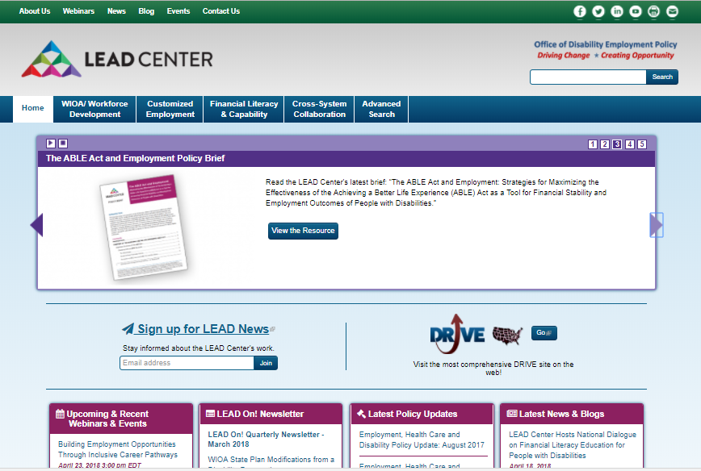
LEAD Center website
Notes:
Rebecca

Slide 41
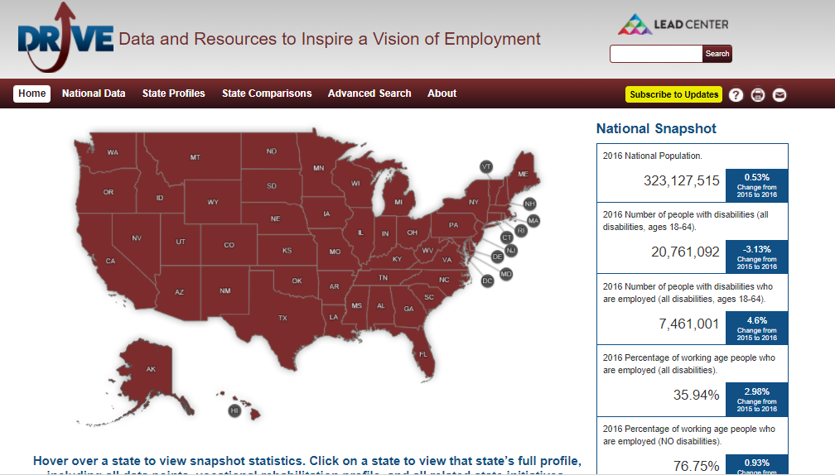
Drive homepage
Notes:
Rebecca

Slide 42
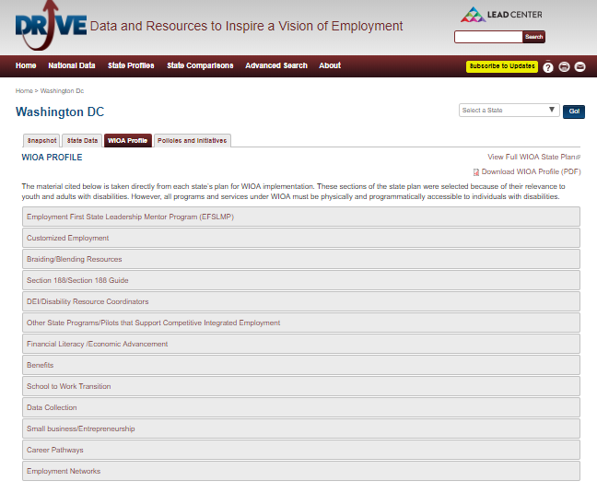
WIOA Profile for district of columbia
Notes:
Rebecca

Slide 43
Section 188 Disability Reference Guide
Promising Practices in Achieving Universal Access and Equal Opportunity: A Section 188 Disability Reference Guide
https://www.dol.gov/oasam/programs/crc/Section188Guide.pdf
The Reference Guide was jointly developed by:
Civil Rights Center (CRC)
Employment and Training Administration (ETA)
Office of Disability Employment Policy (ODEP)
With support and assistance from ODEP’s LEAD Technical Assistance Center at the National Disability Institute.
Notes:
Rebecca

Slide 44
Section 188 Guide correlates with federal requirements
The promising practices in the Guide correlate with the nondiscrimination (equal opportunity) and universal access requirements of Section 188 as previously defined in the Workforce Investment Act (WIA):
Reference Guide does not create new legal requirements or change current legal requirements;
Promising practices do not preclude states and recipients from devising alternative approaches;
Adoption of promising practices will not guarantee compliance.
Notes:
Rebecca

Slide 45
188 Guide SECTION ONE: universal access best practices
Partnerships with Diverse Disability Groups
Resource Mapping and Coordination
Disability Knowledge of Staff
Training Opportunities around Disability
National/State/Local Disability Resources/Supports
Notes:
Rebecca/Jamie

Slide 46
188 Guide SECTION TWO: equal opportunity best practices
Provide Reasonable Modifications of Policies, Practices, and Procedures
Ensure Legal Practices around Asking, Telling, Using, and Storing of Disability-Related Information
Representation of People with Disabilities in All AJC Services and Programs
Referrals of People with Disabilities to Separate Programs are Not Automatic
Notes:
Rebecca/Jamie

Slide 47
Customized employment promising practices
Guided Group Discovery Curriculum Materials (including a Facilitator Manual and PowerPoint, and a Participant Workbook with its Blueprint for Employment), an approach designed to lay the foundation for competitive integrated employment as a Universal Design that can benefit all job seekers.
Guided Group Discovery: Paving the Way to Employment Webinar, in which LEAD Center shares materials used to implement Guided Group Discovery through cross-system partnerships.
The Essential Elements of Customized Employment for Universal Application Manual, a guide for the universal application of elements of Customized Employment across service delivery and training providers approaches.
Self-Guided Discovery Facilitator's Guide: Helping People Discover Their Own Path to Employment, an approach that applies Customized Employment strategies effective for anyone
Notes:
Rebecca

Slide 48
STATE STRATEGIES
FOR IMPLEMENTING
SECTION 188
Notes:
Jamie

Slide 49
State Strategies for implementing section 188
State strategies implementing effective AJC Certification processes, with Section 188 as framework.
Missouri
Section 188 Disability Reference Guide
Equal Opportunity Officers & Vocational Rehabilitation Partnership
Virginia
State Cross Partner & Cross Title Taskforce
Diverse Workforce & Disability Taskforce, Policy Administrator
California
Continuous Improvement Matrix
Levels of Certification: Baseline & Hallmarks of Excellence
Notes:
Jamie (LAUREN TO ASK ABOUT WHAT THE SECTION 188 PROGRAM FRAMEWORK, PROGRAM DESIGN, BUDGET, ETC. LOOK LIKE IN OTHER STATES)

Slide 50
Connect with the LEAD Center
Website: www.leadcenter.org
DRIVE Website: http://drivedisabilityemployment.org/
Sign up for LEAD Center News: http://eepurl.com/sQiHr
Follow the LEAD Center on…
Facebook: www.facebook.com/LEADCtr
Twitter: @LEADCtr
LinkedIn: linkedin.com/groups/LEAD-Center-4828089
YouTube: https://www.youtube.com/user/LEADCtr
Contact us:
Rebecca Salon, Project Director, rsalon@ndi-inc.org
Elizabeth Jennings, Asst. Project Director, ejennings@ndi-inc.org
Aramide Awosika, Project Coordinator, aawosika@ndi-inc.org
Notes:
Jamie

Slide 51
Connect with DEI & eta Disability employment resources
WorkforceGPS DEI Collection: https://dei.workforcegps.org/
Front Line DEI Resources: https://dei.workforcegps.org/resources/2017/11/17/13/18/Front_Line_DEI_Resources
DEI Best Practices Highlights: https://disability.workforcegps.org/resources/2017/09/14/13/01/Disability_Employment_Initiative_DEI_Best_Practice_Series
WorkforceGPS Disability and Employment Community: https://disability.workforcegps.org/
Join “Connect the Pieces”: https://www.workforcegps.org/register
Online resource destination for the AJC network, people with disabilities, and employers and stakeholders who partner with the workforce system to provide services/programs to people with disabilities and other barriers to employment. Check the “Disability and Employment” box and other community memberships that can support your work.
Notes:
Jamie

Slide 52
April 30, 2018
3:00-4:00pmEST
REGISTER HERE: https://leadcenter.webex.com/leadcenter/onstage/g.php?MTID=e025cb1f8932f02359c28c1e57b47f74e
Achieving 188 Compliance & AJC Certification: Key Strategies & Actions from Policy to Procedure
Notes:
Jamie

Slide 53
NEXT STEPS FOR
THE DISTRICT OF COLUMBIA
Notes:
Lauren
GROUP DISCUSSES NEXT STEPS BASED ON BASED ON INFORMATION DISCUSSED; CAPTURE FEEDBACK

